Slide 1

Creating Business Process Tests

Slide 2

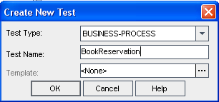

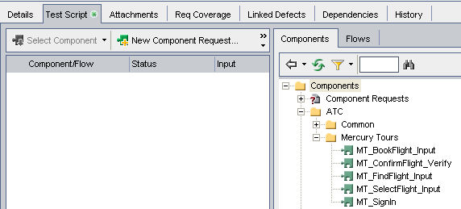
Creating Business Process Tests
Select QC Test Plan module.
Select New Test.
Select an existing component or create a New Component Request.
Notes:
Test Type is “Business-Process”.
Test Names should be meaningful and consistent with standards adopted by your team.
On Details Tab, provide Free Form Text describing this Test Case
Test Type is

Slide 3
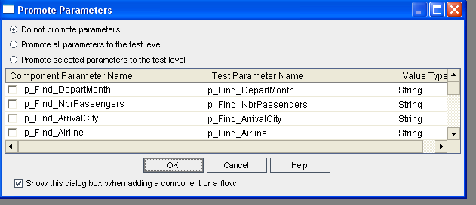
Creating Business Process Tests
When adding a component or flow to the Test Case, the Promote Parameters dialog box is displayed.
3

Slide 4
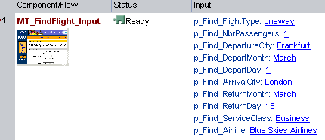
Creating Business Process Tests
If Do not promote parameters is selected, run-time parameters are not created. The parameter default value will be displayed if one was provided for the parameter.
4

Slide 5
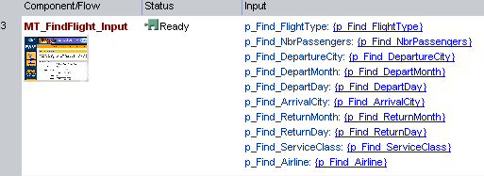
Creating Business Process Tests
If Promote is selected for some or all of the parameters, the appropriate run-time parameters are created.
5
Notes:
Run-time parms are enclosed in curly brackets.

Slide 6
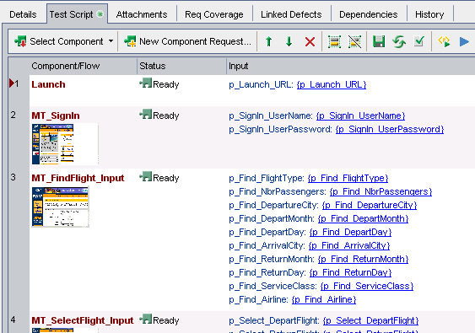
Creating Business Process Tests
The completed Business Process Test contains the selected components and run-time parameters.
6

Slide 7
Question ? Feedback ! Comments !!
Discussion

